Slide 1
Project 6 Accurate Angular Position Controller

Slide 2
Project Description
The aim of this project is to design and implement an Accurate angular position controller that will be used in industries, vehicles and in the manufacture of Robotic arms.
The project is built using a Servo that is geared to change the angular position of the propellers. The angles that are used in this project are 0, 90 and 180 degrees.
The servo motor is controlled by the IR remote with the IR Receiver sensor module.

Slide 3
Components involved
Arduino UNO R3 board
Servo Motor (SG90)
3 x LEDs
3 x 220 ohms resistors
IR Receiver sensor
IR Remote
Breadboard

Slide 4
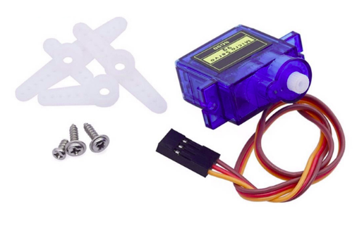
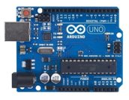
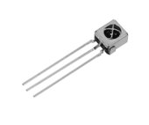


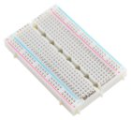

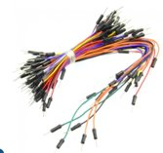
IR Receiver sensor
Servo motor SG90
Arduino UNO R3 board
IR Remote
LED
220 ohms Resistor
Half breadboard
Jumpers

Slide 5
Working principle of Servo motor SG90
Servo motor (SG90) is a type of geared motor that can only rotate 180 degrees.
It is controlled by sending electrical pulses from the voltage source (Arduino UNO board for our case), the pulses tell the servo what position it should move to.
The pulses are of variable width or pulse width modulation. There is a minimum pulse, maximum pulse and a repetition rate.
The PWM sent to the motor determines the position of the shaft, and based on the duration of the pulse sent via the control wire, the rotor will turn to a desired position.
The maximum amount of force that a servo can resist is called torque rating.
The servo will not hold the position forever though; the position pulse must be repeated to instruct the servo to stay in position.

Slide 6
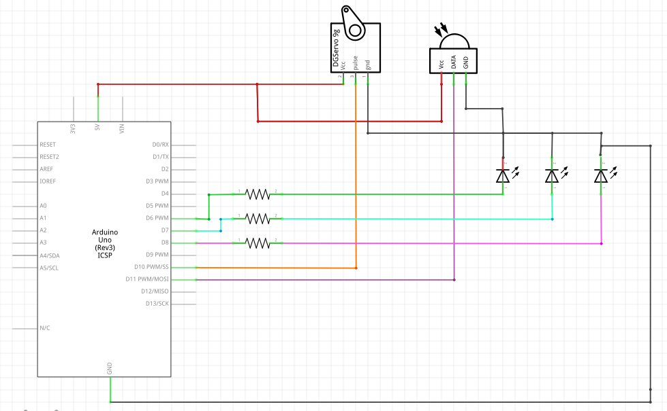
Schematic Circuit

Slide 7
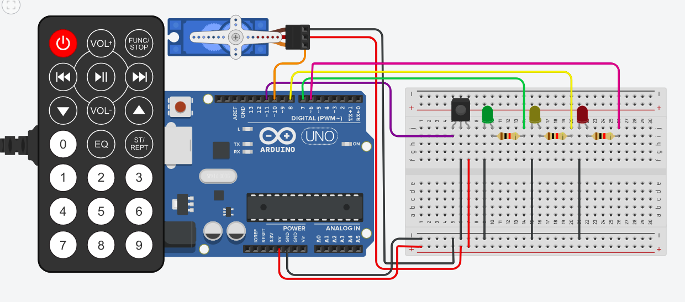
Breadboard Circuit

Slide 8
Applications of the Project
Radio-controlled airplanes to position control surfaces like elevators.
Walking a robot
Operation grippers
In Food services and Pharmaceuticals.
In-line manufacturing where high repetition yet precise work is necessary.

